Slide 1
Lead Scoring Case Study
Presented By:
Ms. Nikita Dandriyal
Mr. Dhruv Garg
Mr. Animesh Dawn

Slide 2
Problem Statement
The problem statement is about X Education, an online education company that sells courses to industry professionals. The company faces the challenge of poor lead conversion rates, with only about 30% of the leads getting converted into paying customers. To improve this rate, X Education wants to identify the most potential leads or "Hot Leads" who are more likely to convert. The company wants to assign a lead score to each lead that reflects their potential to convert. The higher the score, the higher the chance of conversion. The goal is to achieve a lead conversion rate of around 80%.
To solve this problem, we need to develop a lead scoring model that can predict the likelihood of a lead to convert into a paying customer. The model should use historical data on leads, such as their behavior on the website, demographics, and past communication with the sales team, to identify patterns that correlate with conversion. The model should assign a lead score based on these patterns, which can then be used to prioritize leads for the sales team.
The lead scoring model should be designed to optimize the lead conversion rate. We can use techniques such as logistic regression, decision trees, or random forest to build the model. The model should be trained on historical data, and the performance should be evaluated using metrics such as accuracy, precision, recall, and F1 score.
Once the lead scoring model is developed, X Education can use it to prioritize leads for the sales team. The sales team can focus their efforts on the leads with the highest scores, as these are the most likely to convert into paying customers. By focusing on the most potential leads, X Education can improve its lead conversion rate and achieve the target of 80% conversion rate.

Slide 3
GOALS OF CASE STYDY
The main goal of the case study is to develop a logistic regression model that assigns a lead score between 0 and 100 to each lead. The lead score can be used by the company to target potential leads and prioritize them based on their likelihood of conversion. A higher lead score indicates a hotter lead, while a lower lead score suggests a colder lead.
In addition to building the logistic regression model, the company requires that the model can handle potential changes in their requirements in the future. The model should be able to adjust to changes in the company's needs and continue to provide accurate and relevant lead scores.
As for the problems presented by the company, they are not provided in this text. However, the company may have concerns about the accuracy of the model or the interpretation of the lead scores. They may also have questions about the data used to build the model or the potential impact of changes in their business environment on the model's performance. It is important to address these issues in the PPT presentation and provide recommendations on how to overcome them.

Slide 4
STRATEGY
Import data
Clean and prepare the acquired data for further analysis
Exploratory data analysis for figuring out most helpful attributes for conversion
Scaling features
Prepare the data for modal building
Build a logistic regression modal
Assign a lead score for each leads
Test the model on train set
Evaluate model by different measures and metrics
Test the model on test set
Measure the accuracy of the model and other metrics for evalution

Slide 5
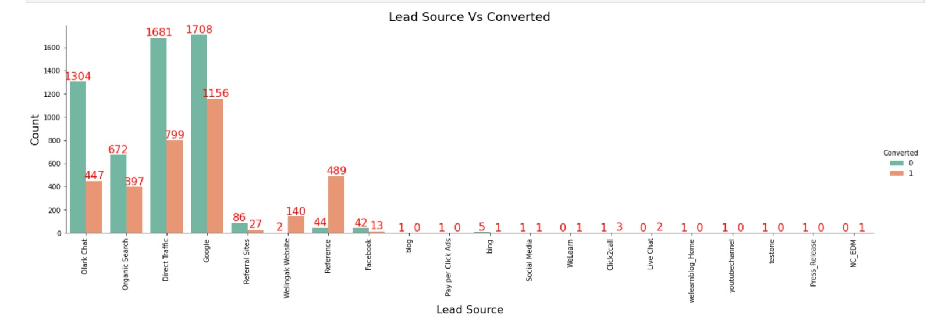
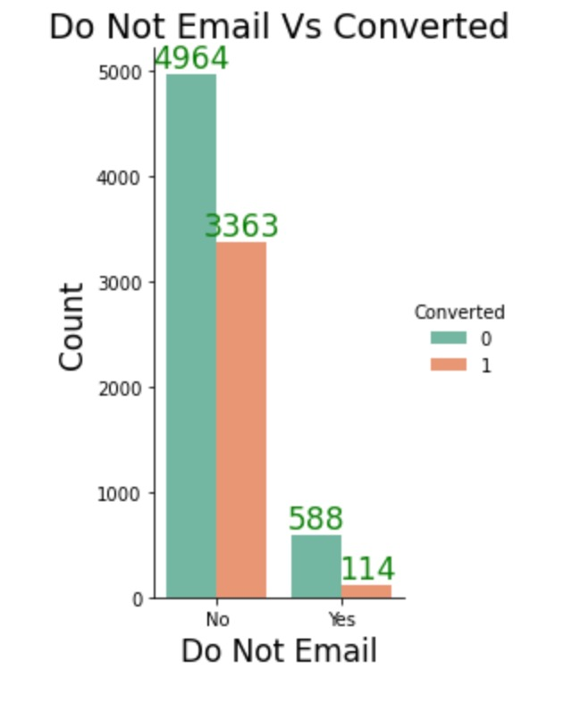
Exploratory data analysis
LEAD SOURCE VS CONVERTED
The lead source is the channel or method through which a lead is generated, such as through a Google search, a referral, or by filling out a form on the company's website. On the other hand, converted refers to whether or not a lead has actually become a paying customer.
DO NOT EMAIL VS CONVERTED
In the context of this case study, "Do not email" refers to leads who have explicitly opted out of receiving emails from X Education. The variable "converted" refers to whether or not a lead has become a paying customer.

Slide 6
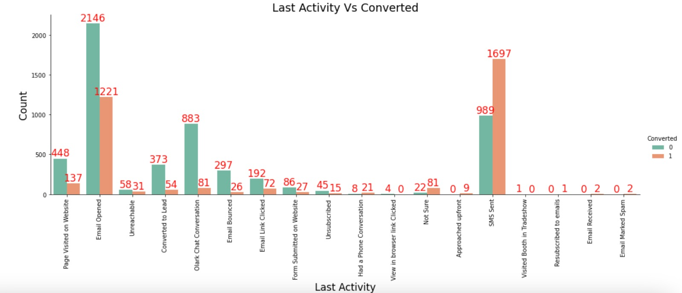
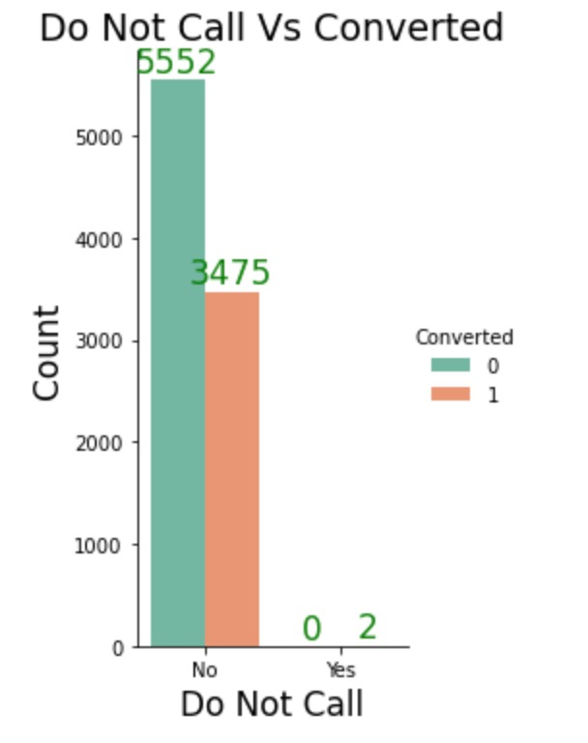
LAST ACTIVE VS CONVERTED
SMS has shown to be a promising method for getting higher confirmed leads, emails also has high conversions.
DO NOT CALL VS CONVERTED
Most lead prefer not to informed through phone

Slide 7
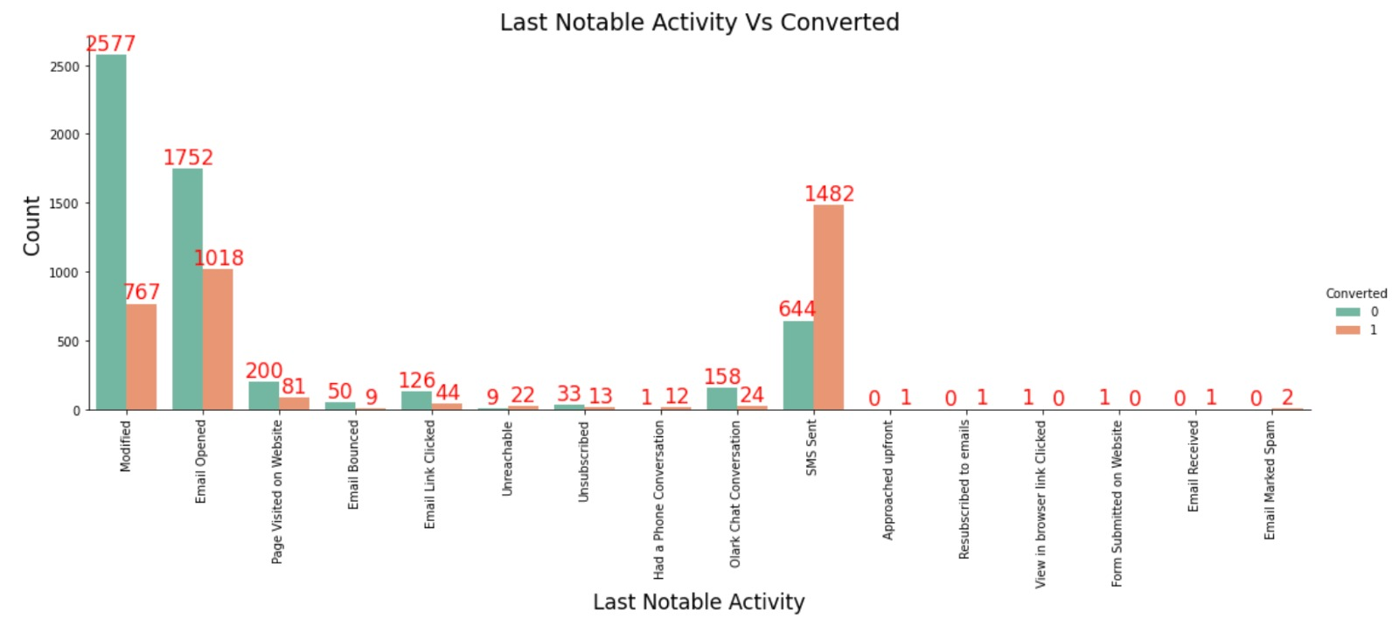
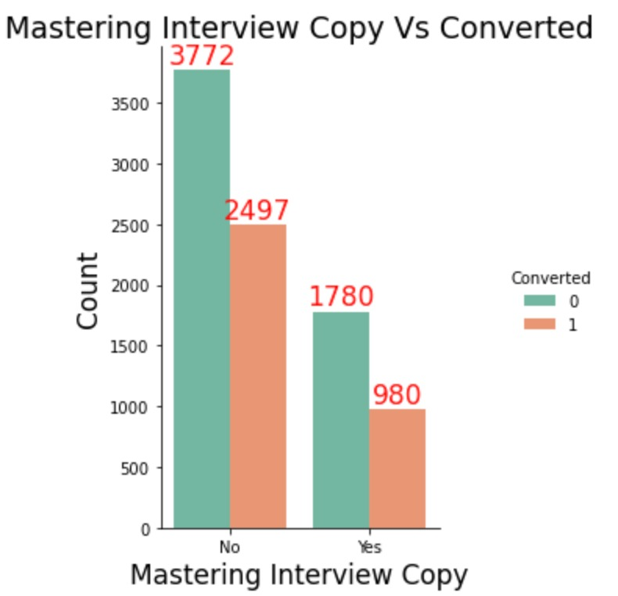
LAST NOTABLE ACTIVITY VS CONVERTED
Most leads are with message. Email also induce leads.
MASTERING INTERVEIW COPY VS CONVERTED
Leads prefer less copies of interviews

Slide 8
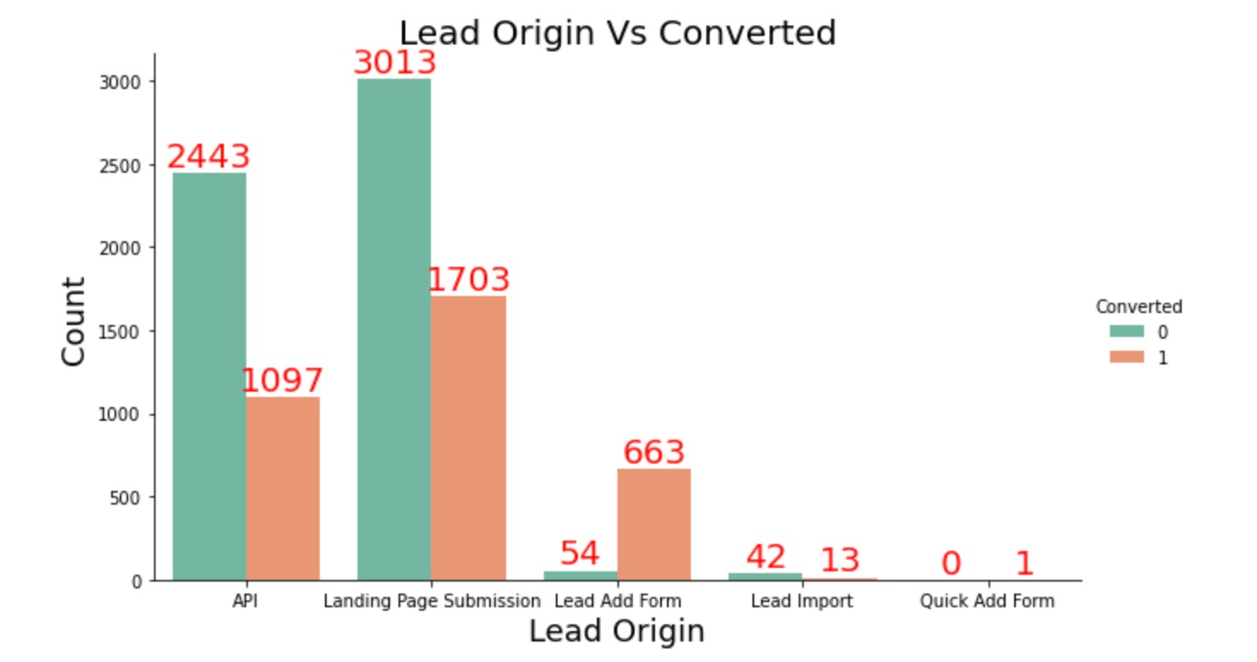
SPECIALIZATION VS CONVERTED
Most of the lead have no information about specialization.
On the other hand,
Marketing management, human resources management has high conversion rates. People from these specializations can be promising lead
LEAD ORIGEN VS CONVERTED
Landing page submission has had high lead conversion

Slide 9
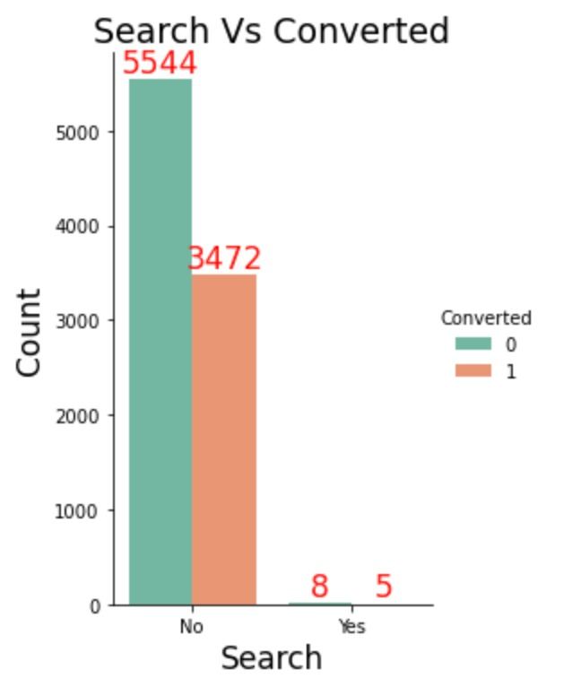
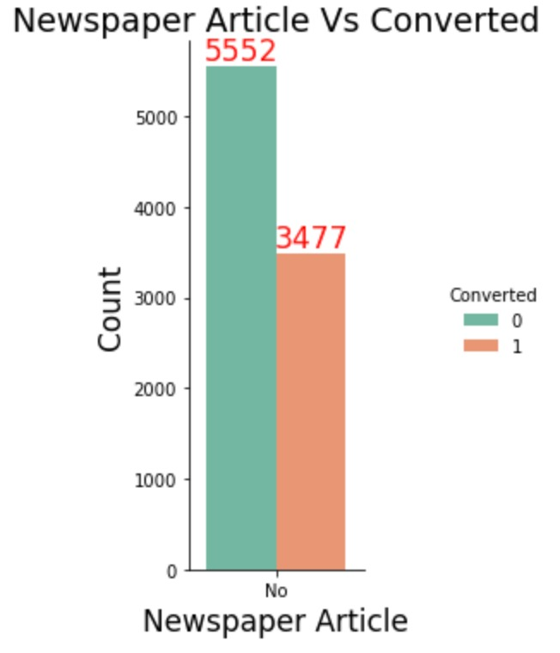
SEARCH VS CONVERTED
The above graph shows search are not good source of leads
NEWSPAPER VS CONVERTED
NEWSPAPER do not have higher conversion rate

Slide 10
MODEL BULDING
Splitting into train and test set
Scale variables in train set
Build the first model
Use RFE to eliminate less relevant variables
Build the next model
Eliminate variables based on high p-values
Check VIF value for all the existing columns
Predict using train set
Evaluate accuracy and other metric
Predict using test set
Precision and recall analysis on test predictions

Slide 11
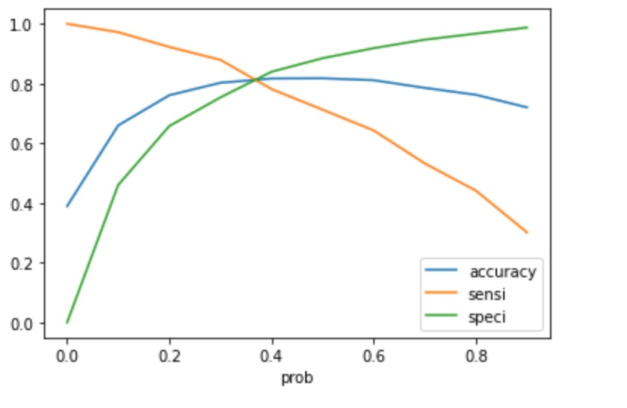
Model evolution (train)

Slide 12
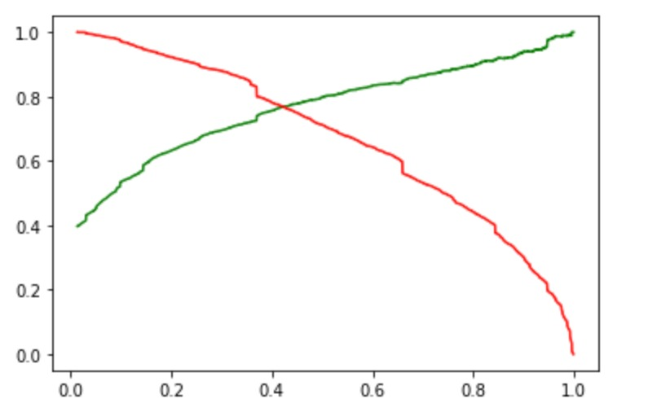
Model evaluation (test)

Slide 13
conclusion
The conclusion suggests that the model has been evaluated using multiple metrics to determine its effectiveness.
The optimal cut off has been determined based on sensitivity and specificity.
The accuracy of the test set is around 81%, which indicates that the model is performing reasonably well.
The sensitivity of the test set is around 79%, indicating that the model is able to identify a large proportion of true positives.
The specificity of the test set is around 82%, indicating that the model is able to correctly identify a large proportion of true negatives.
The test set results are consistent with the values obtained from the trained set, indicating that the model is generalizing well.
The lead score calculated in the trained set of data suggests a conversion rate of around 80%, indicating that the model is likely to be effective in practice.
The conclusion suggests that overall, the model is good, which is a positive assessment of its performance.
It is important to note that further validation and testing may be necessary before the model is deployed in practice.
Overall, the conclusion provides a summary of the key findings of the analysis and suggests that the model is a promising tool for predicting outcomes.

